Slide 1
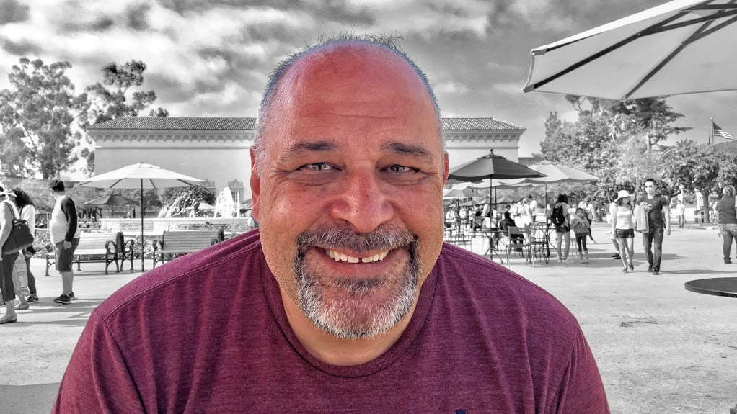
Computer Systems and C Programming
Prof. Darrell Long
CSE 13S
When the going gets weird, the weird turn pro. —Dr. Hunter S. Thompson

Slide 2

This is a hard class
This course is foundational.
What you learn will be used from now on.
It is 7 Units, combining the old CMPE 13 and CMPE 13L.
You must pass all laboratory components to pass the course.
That fact is not meant to scare you

Slide 3
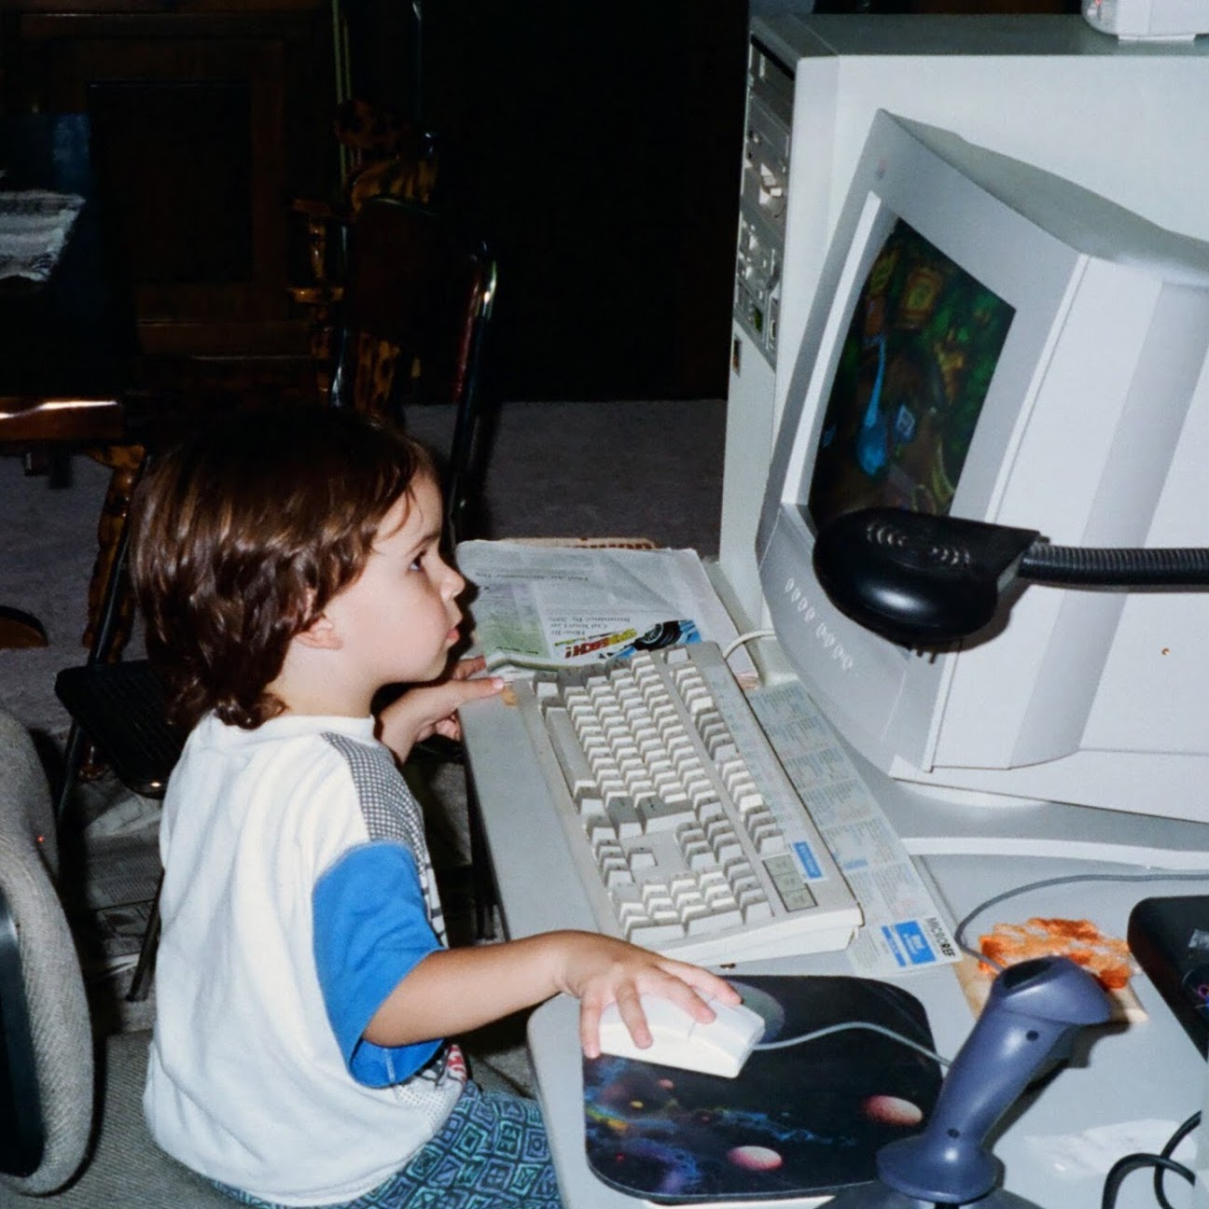
What am I expected to know?
Timon & Pumbaa’s Jungle Adventure
High school algebra:
Ideally, you know a little Calculus.
How to compose a paragraph in English.
You are expected to use correct grammar and spelling.
Some exposure to programming, for example, Python.
The material from CSE 12/L:
Binary Arithmetic
Memory
Registers
Pointers
Instructions
Addressing modes
John Long
Video Game Test Engineer

Slide 4


More assumptions
Dr. Long
Age 3
You have access to a computer.
You have a virtual machine running Ubuntu Linux.
You have created your account on git.ucsc.edu
You have written at least a simple program in a higher-level language.

Slide 5

Wait? What? Writing!?
And further, by these, my son, be admonished: of making many books there is no end; and much study is a weariness of the flesh.
Ecclesiastes 12:12
Yes, as an Engineer, you must know how to write:
Proposals,
Status reports, and
Documentation.
Your language usage must be correct.
There are tools to help you:
Spelling checking programs.
Grammarly
The university provides a subscription.

Slide 6
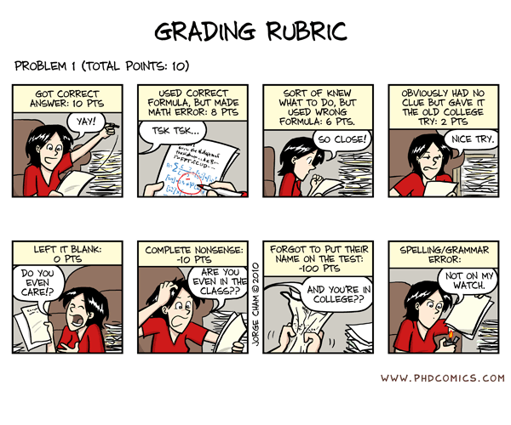
Grading
Assignments: 50%
Examinations: 30%
Quizzes: 20%
We do not have the resources to grade extra credit.
Be sure that you do each and every assignment.
You must pass every assignment in order to pass the class.
Notes:
Photo from the movie Evil Dead.

Slide 7
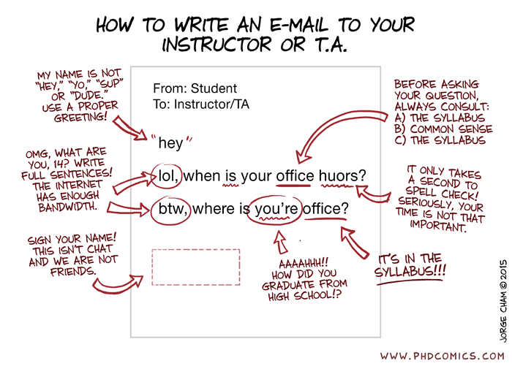
Be nice to the TA and the graders

Slide 8
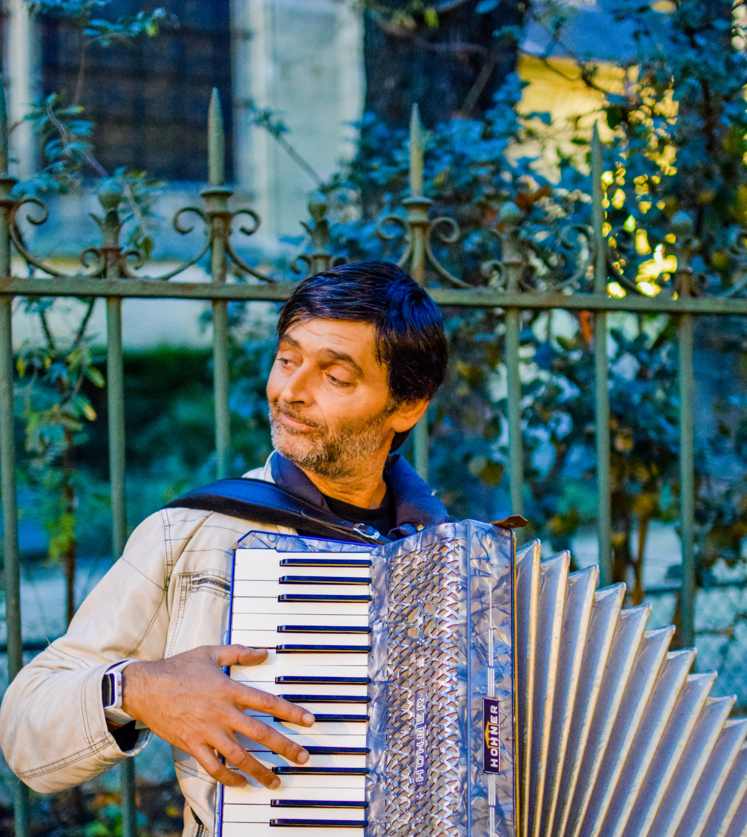
DRC Accommodations
I must remember to tell them in advance!
Contact TA Yiyuan Luo (yluo124@ucsc.edu) if you have DRC accommodations.
Only then can we accommodate your testing and assignment requirements.
We can offer at most 2 extras days for programs.
2× on tests does not mean double time for programs.
If you are going to be late, you must tell us 2 days in advance!

Slide 9
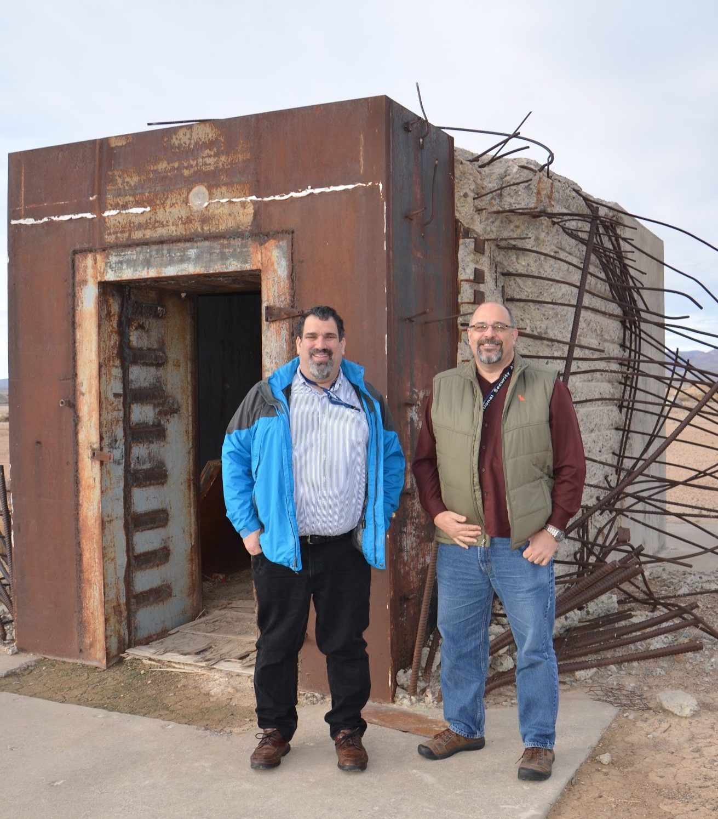
Forms of Address
Bank vault destroyed by an atomic bomb (really)
Dr. Miller
Dr. Long
You can call me:
Dr. Long
Prof. Long
Monsieur le Professeur Long
No one calls me by my first name, except my wife.
I will address you in any manner that you prefer, so long as it is polite.
If I forget, just remind me.

Slide 10
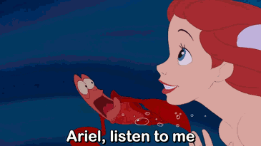
You will write a lot of programs in C
You may have seen Java or Python, but now it’s time to learn C.
You will:
… need to worry about memory,
... use pointers,
... manipulate bits,
... use an actual editor,
... use UNIX (Linux), and
... use tools like git, vim, make, cc, lldb, etc.

Slide 11
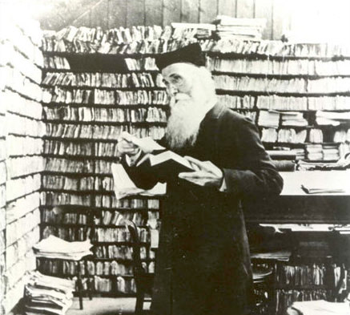
You will be busy
Do not think that you can do it the night before…
Do not think you can do it the day before that…
In other words, start on it early.
Many of you will not heed this warning: and you will regret it.
Programming requires practice.
It requires thought.
It requires the willingness to rewrite your code.
Sir James Augustus Henry Murray, LL.D.

Slide 12

You will get your hands dirty!
This class will show you where the bits hit the silicon.
You will write most of the code that you use:
In contrast to some classes which teach you which libraries to use and give you code templates to fill in.
Ever wonder how a Python dictionary works?
You’re going to find out, it’s called a hash table.
How about those lists in Python?
We will look at arrays as well as linked lists.
Mike Rowe
A Personal Hero

Slide 13

Reading
Necronomicon
Many students have suffered for failing to read the book…
In order to succeed in your classes you must read the material.
You cannot pass this course by simply:
… listening to lectures,
… reading these slides, or
… watching YouTube videos.
Read the appropriate section of the relevant book before you ask me, the TA, or the Tutor for help.
If you have not done your part and completed the reading, you will go to the back of the line so that we can help students who have done the reading.
Notes:
Photo from the movie Evil Dead.

Slide 14
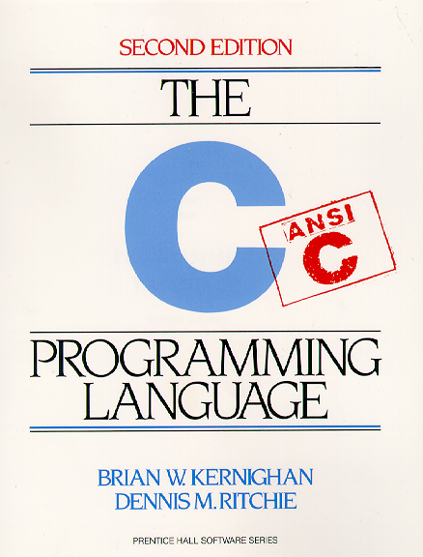

The C Programming Language
The beauty and the danger of C is its simplicity.
C gives you more access to the raw machine than any language other than assembly language.
C does not hold your hand. It will not protect you from your mistakes.
C requires you to think about what you are doing.
C will do exactly what you ask of it.
It is rather like giving a monkey a chainsaw.
Notes:
Treebuzz.com

Slide 15
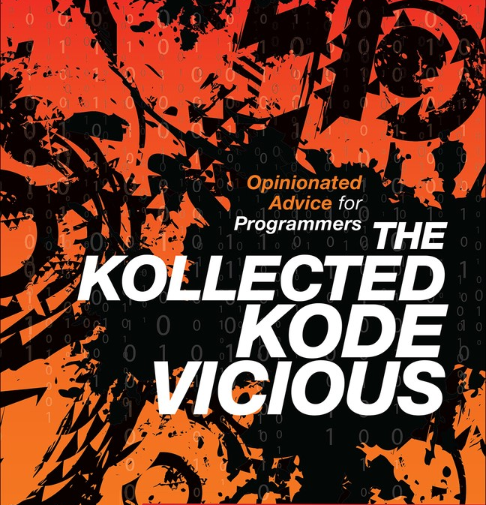
It’s about learning how to program
Programming is not simply learning C, or Java, or Python.
It is learning how to think!
There is a lot of difference between an adequate programmer and a good programmer,
And even more difference between a good program and a great programmer.
Get the book, it’s free to you on O’Reilly!
The difference between theory and practice is greater in practice than in theory. —John Wilkes

Slide 16

Programming can be a lot of fun!
Getting good at programming requires practice!
That’s true for any worthwhile activity…
Like skateboarding, or
Surfing, or
Playing guitar.

Slide 17
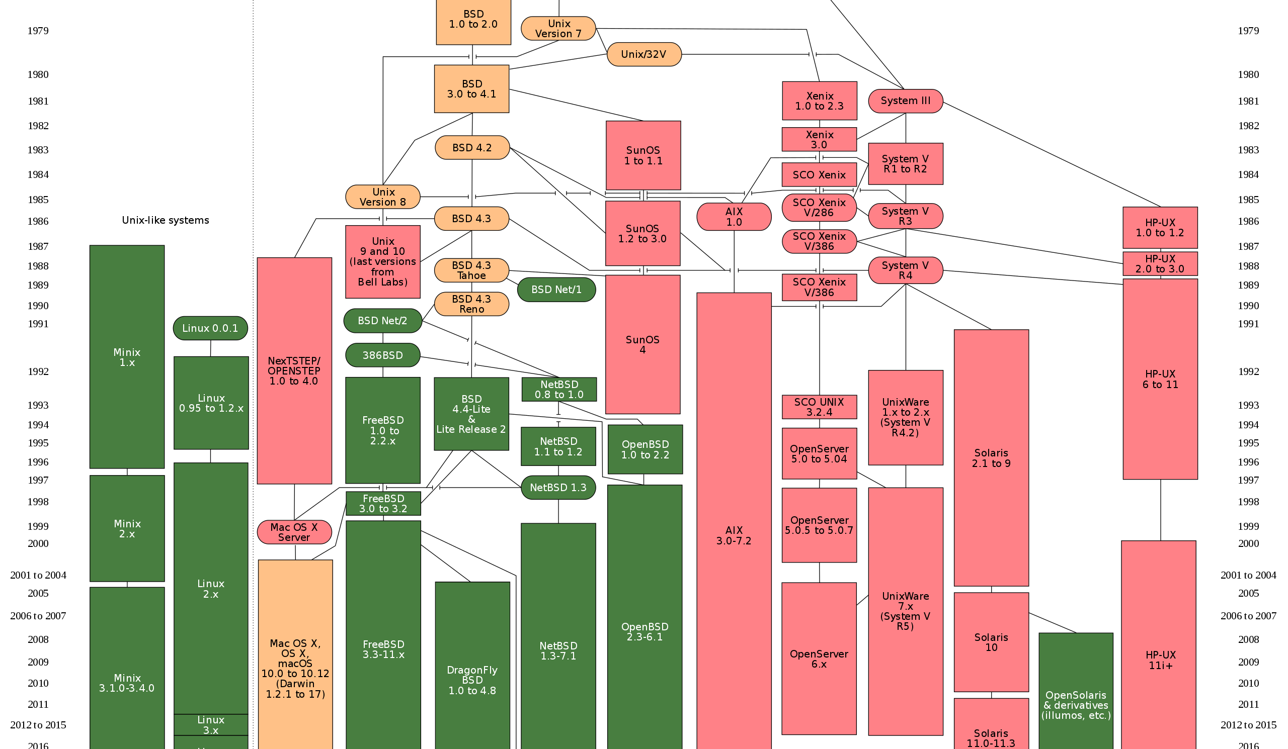
The UNIX Operating System
Developed in the 1970s after MULTICS proved too ambitious.
UNIX is an operating system for programmers.
There are many versions of UNIX.
More computers run a version of UNIX than any other operating system.
Most phones, routers, data centers, … run some version of UNIX.
Why has it lasted so long?
It has an effective programming model.
Simplicity and elegance do matter.

Slide 18

You must use UNIX (Linux/Ubuntu)
You do not have a choice in this matter.
No, you must not use a Windows IDE.
If we catch you, then you get a zero.
You can run Linux native on your computer.
You can install VirtualBox and run Linux on that.
You can use: cse13s.soe.ucsc.edu
I personally favor the virtual machine approach.

Slide 19

O’Reilly Safari Books
You are fortunate to have access to many resources available on-line:
https://proquest-safaribooksonline-com.oca.ucsc.edu
Here are some of the books you will want to consult:
Loeliger & McCullough, Version Control with Git
Newham, Learning the bash Shell
Robbins, Lamb & Hannah, Learning the vi and Vim Editors
Robbins, Siever, Figgins & Robert Love, Linux in a Nutshell
Crawford & Prinz, C in a Nutshell
Mecklenburg, Managing Projects with GNU Make
This includes most of the O’Reilly books.
Be smart: make good use of this resource.
Read? Who, me?

Slide 20
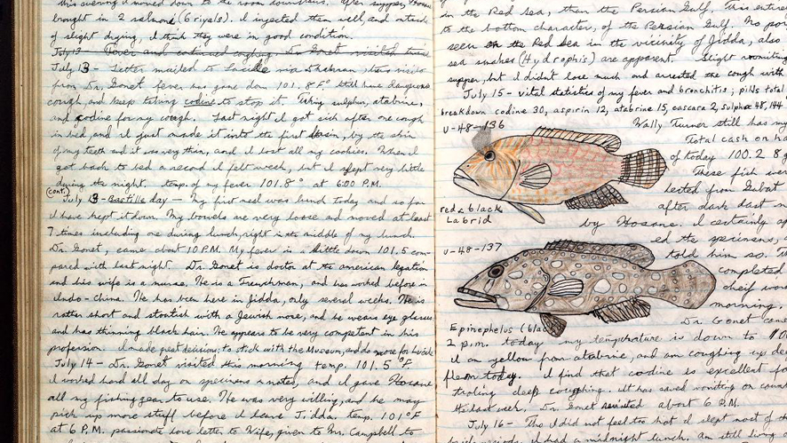
Taking Notes
Taking notes is essential for success in this course.
Doing so means you can use them on tests.
You cannot rely on simply reading the slides:
A lot will be said that is not on the slides.
You should turn in your notes before Monday of the following week using git.
PDF or plain text, Word will not be accepted.
If you do, you get a prize: you can use them to create your cheat sheet!
Your goal in this course is to learn, not to pass.
Unlike high school, you do not cram, test and forget.
Many of you will try, and you will not succeed.
Notes:
Stock photograph taken from the Internet.

Slide 21

Secrets of Success
Start projects early.
You can always finish early and take the last day off …
Write your design document before writing code.
Think first, code second.
Use debugging and analysis tools.
You can study together but:
All code must be your own!
If you don’t understand something, then ask.
Do not wait until the last minute!

Slide 22
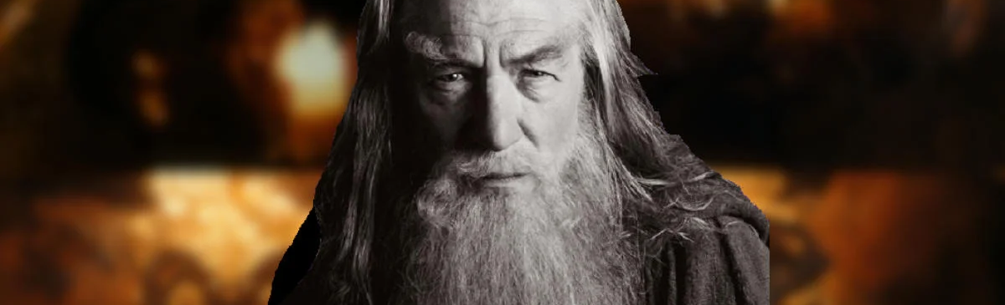
Cheating
If you cheat…
You shall not pass!
You should all know what cheating is,
But in case you do not, you will all be signing an acknowledgement regarding it.
Using code that you did not write is cheating,
Including code on the Internet.
If you use code from others, including the TA, Grader, Tutor, … you must acknowledge that person.
You had better not use Chegg or similar web sites.
Every term some student hired a rent-a-coder (and yes, we figure it out).
You will fail and it will not be a slap on the wrist.
Notes:
This meme was taken from the Internet.

Slide 23
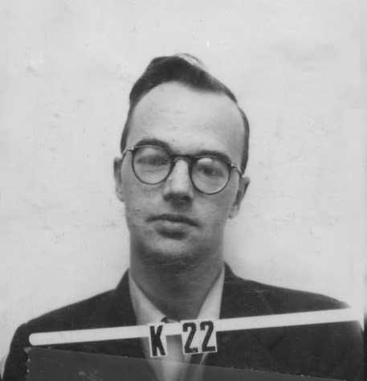
Examples of Prohibited Activity
You may not work on your assignment with anyone.
You may not show your code or design to anyone.
You may not have anyone “walk you through” an assignment, describe a solution in detail, or sit with you as you work on it.
This includes hired tutors.
You may not post code from your project on-line in questions when you ask others for help.
You may not hire some guy from Pakistan to write your code for you.
Yes, people have tried this (and failed).
This list is not exhaustive.
Klaus Fuchs
Engaged in very prohibited activities
Notes:
Do kids still read Mad Magazine?

Slide 24
The Internet does not have all of life’s answers
Avoid the temptation to “just Google it”
Your task is to think and to learn.
We know how to use the Internet too, and if you copy code, we will probably catch you.
We prowl the cheating and rent-a-coder web sites.
We run cheat-checking tools.

Slide 25
Programming Schedule
Programs are assigned by Monday night.
Design documents are due Friday night.
Preliminary design is 50% of the design grade, and
Final design is the other 50% of the design grade.
Programs are due on Sunday night.
No design on Friday? Zero on the design document — no excuses!

Slide 26
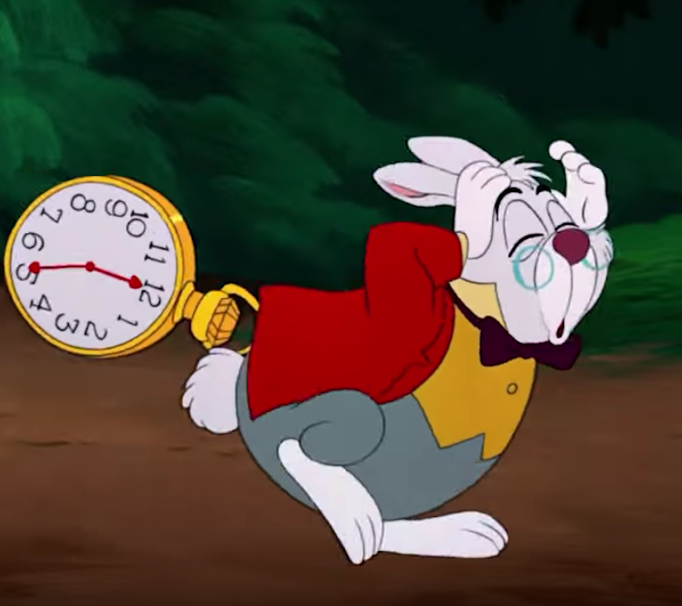
Late Policy
If you turn in your programs late, then you lose:
15% each day for up to 3 days.
After 3 days you get a zero.
There are very few valid excuses.
“But the dog ate my computer!”
Using git lets you recover!
You’ve been admonished to start early!

Slide 27
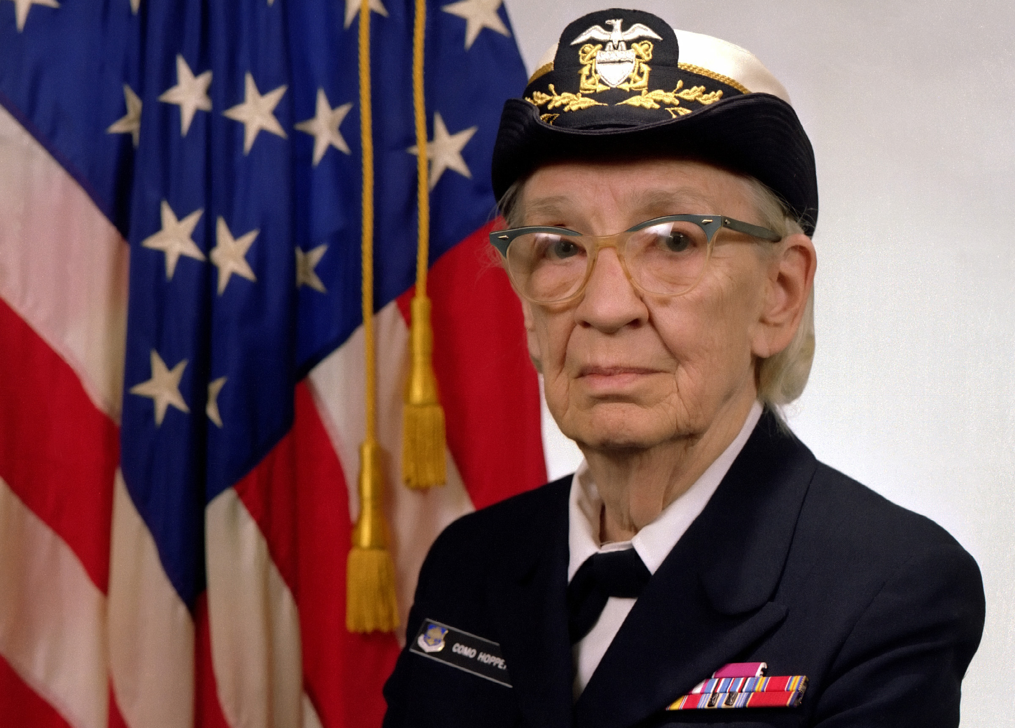
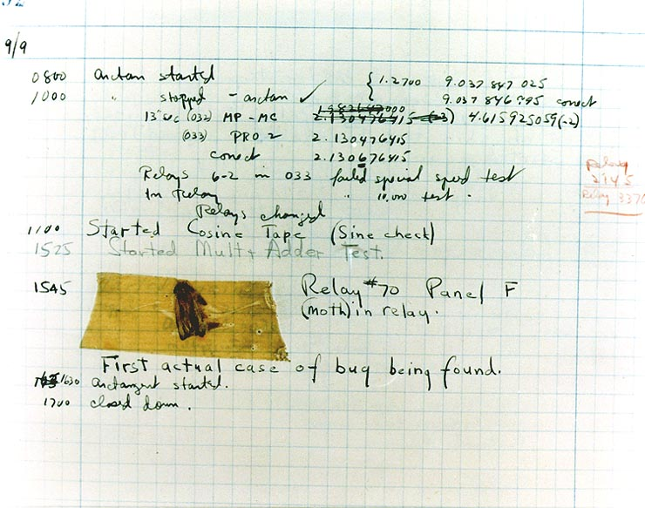
Today’s Tools
RADM Grace Hopper
Created one of the first compilers
Also documented the first real computer bug!
Editor
Compiler
git
Command line

Slide 28
Let’s get you on the virtual machine
We’ll make an ssh key
Make directories
Clone a repository
… And pretty much complete assignment 0

Slide 29
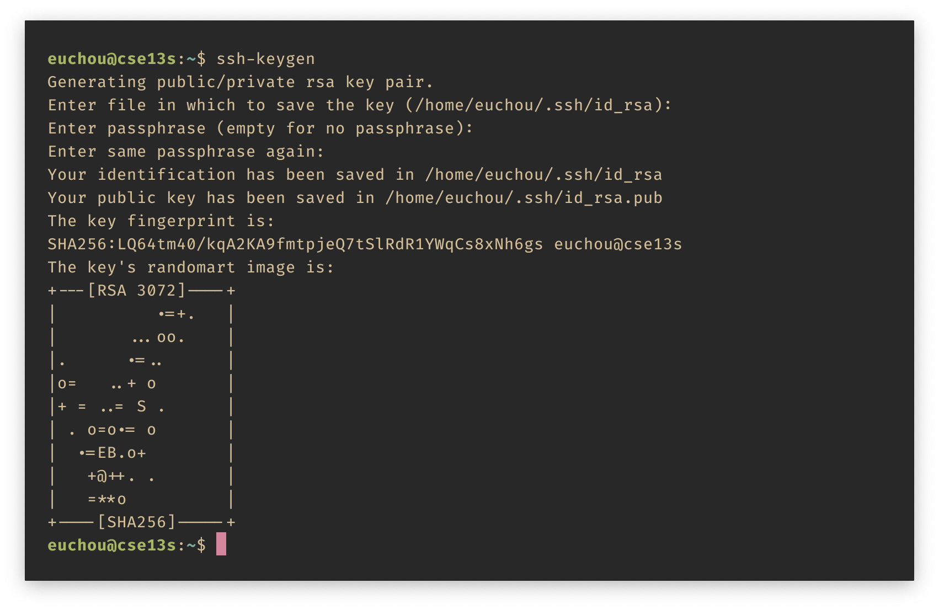
Create an ssh Key

Slide 30
What is ssh?
It is a family of programs that let one computer communicate with another.
ssh — Secure Shell
scp — Secure Copy
sftp — Secure FTP
Data is compressed and encrypted before sending it over the network.
Authentication is provided by Public Key Cryptography.

Slide 31
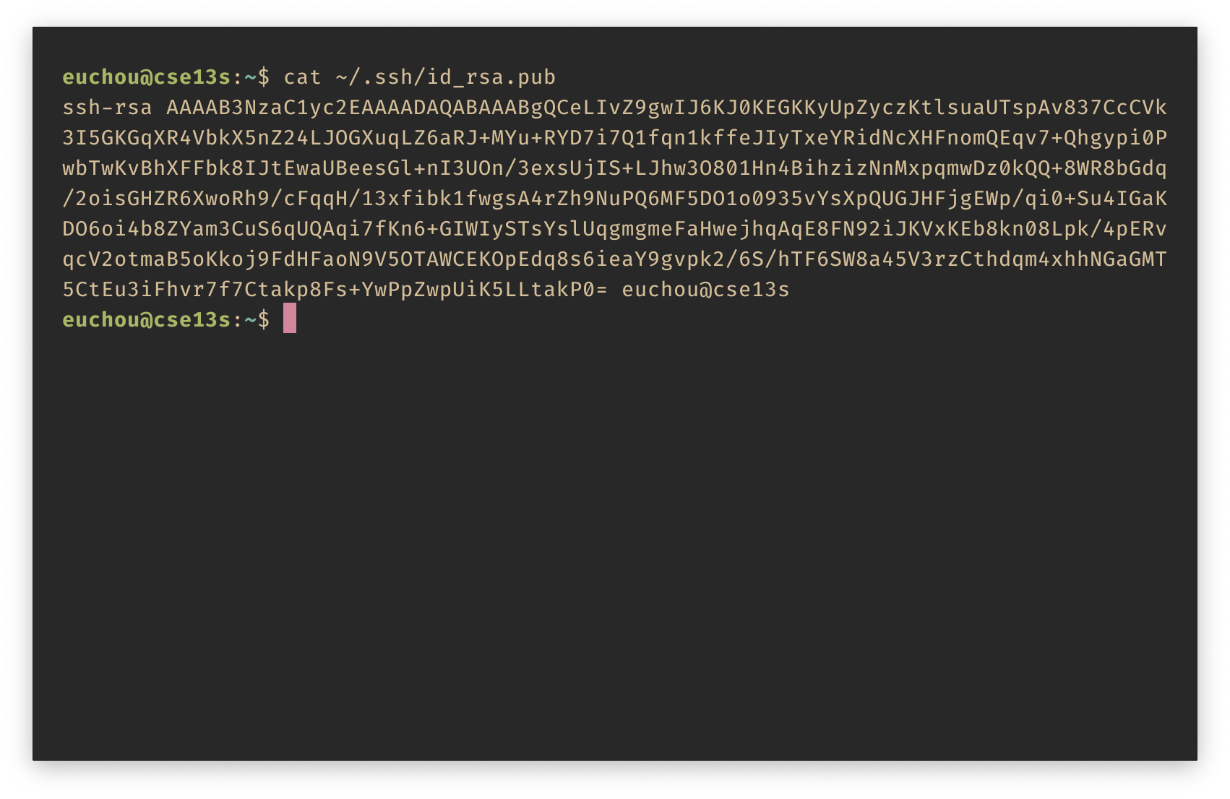
ssh Public Key

Slide 32
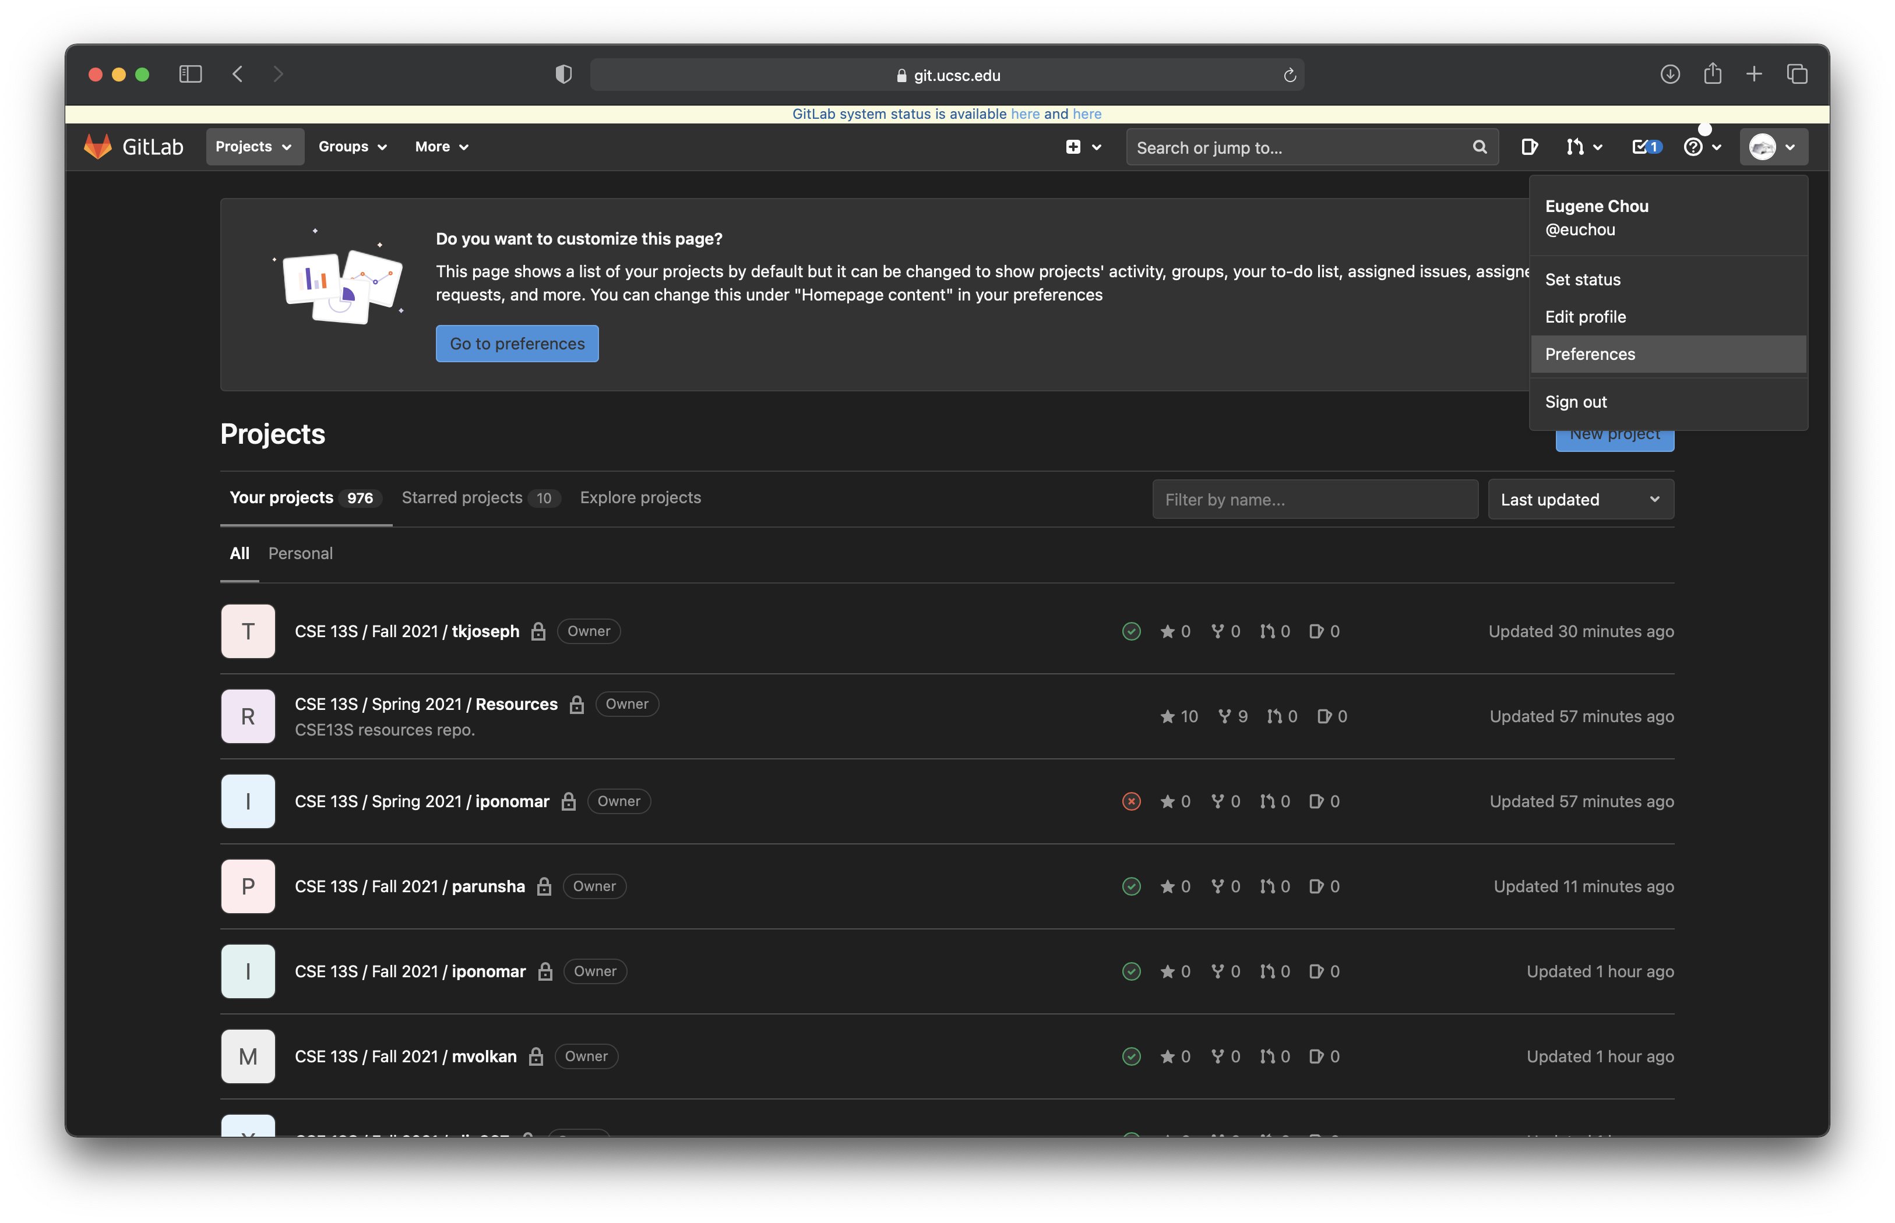
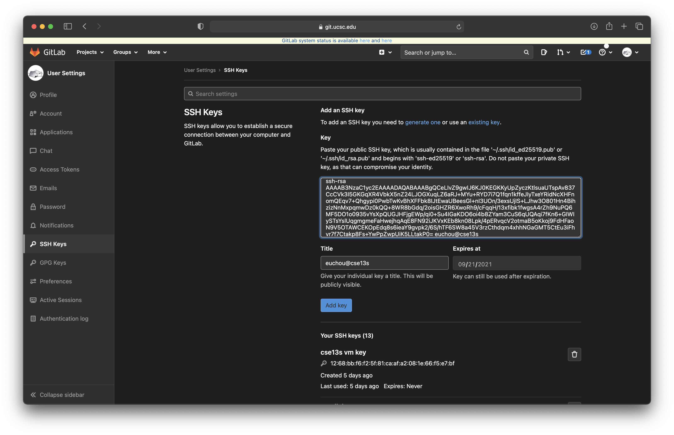
Adding the public key

Slide 33
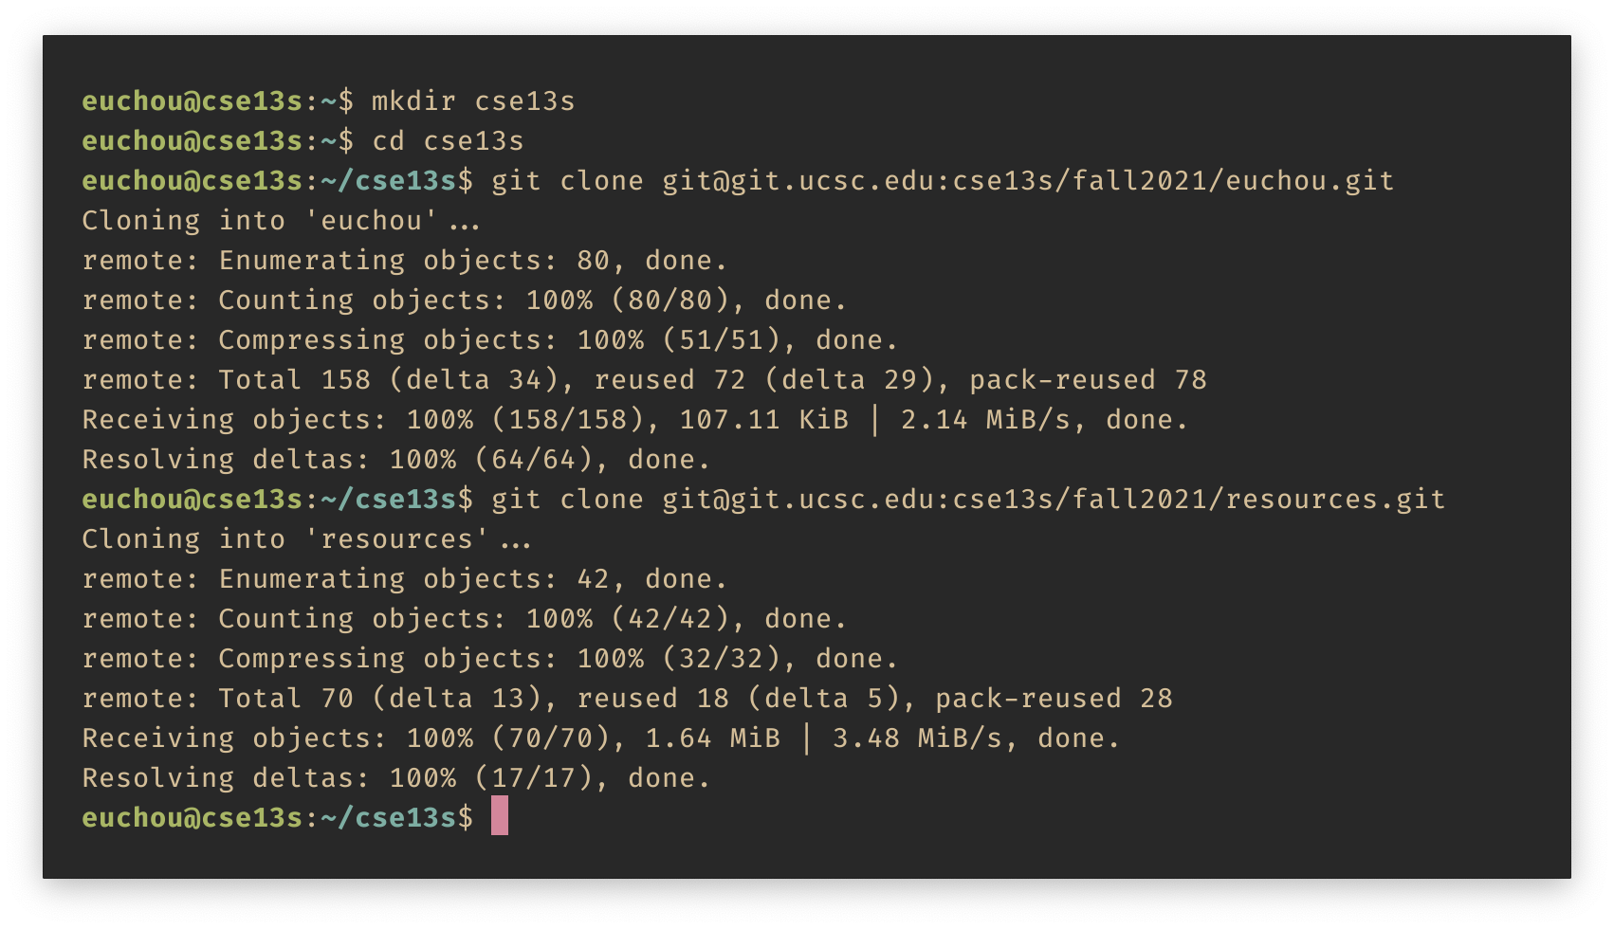
Clone the Repositories
Use the correct term
Make a directory for coursework
Enter the directory
Use your CruzID

Slide 34
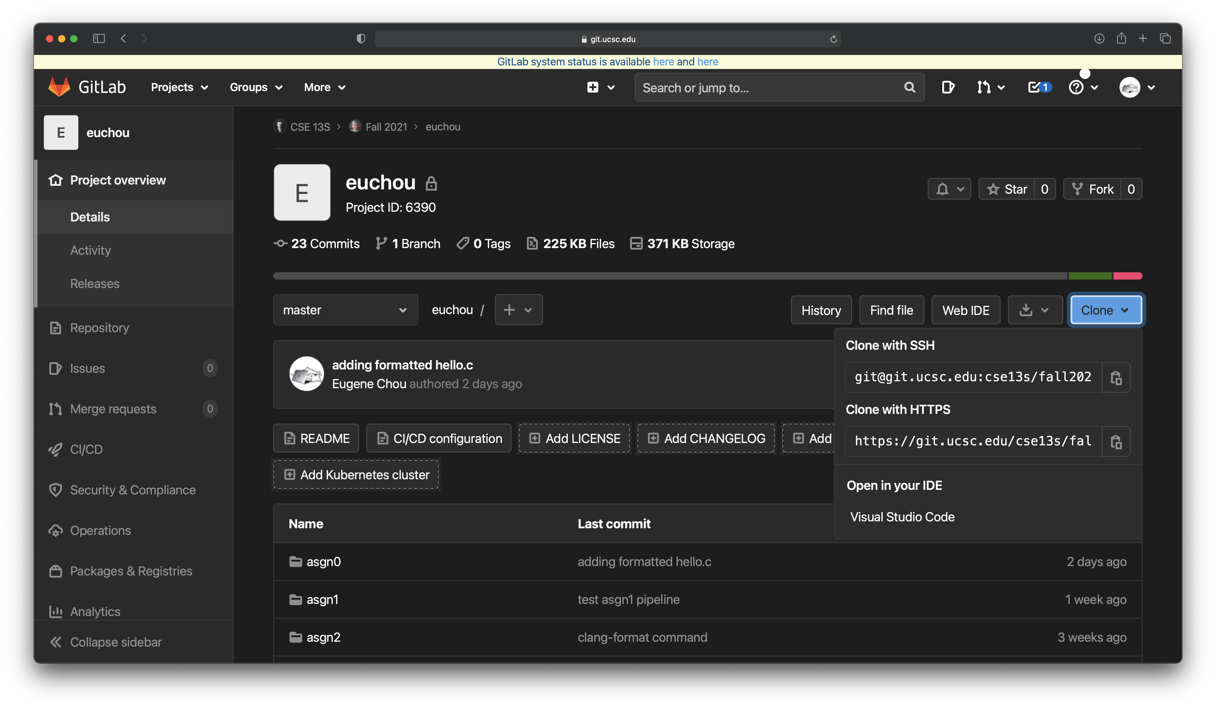
Where did you get that?
Copy this URL

Slide 35
What is git?
It is a Source Code Control system.
It tracks files and the changes to those files.
It is a collaboration tool.
It allows multiple people to work independently and then merge their work.
It is your best friend
When you lose a file, or
When you mess things up and want to go back.

Slide 36
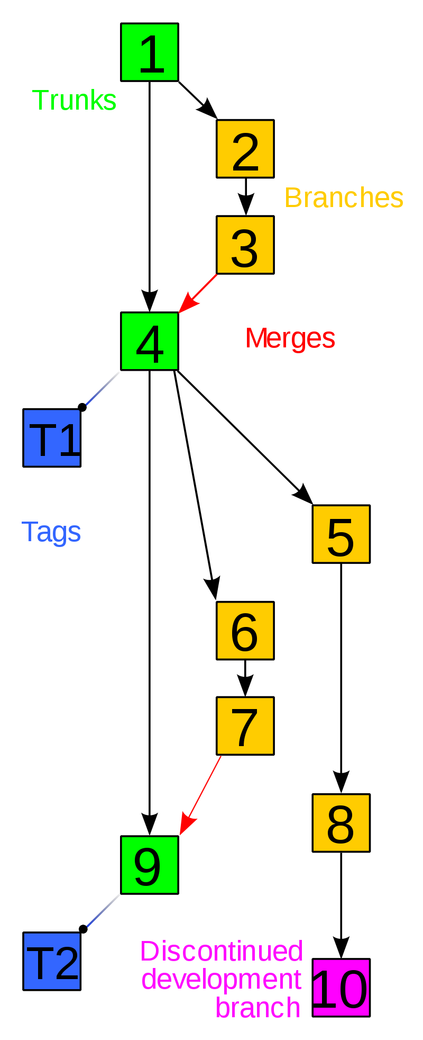
Source Code Control
git is the source control system that you will use during your education.
It is among the most widely used.
Keeps multiple versions of your files.
That means if you make a mistake you can go back to an earlier version.
You can share your files with others in a controlled fashion, and
You can reconcile divergent versions of your files.
Files are stored in a repository.
Stores are opaque chunks (do not mess with them).
The repository represents the history of each file.
You have a local repository that you can synchronize with the one stored on the server.

Slide 37
A little more about git
Files are stored in a repository
The .git directory contains indexing information and a content-addressable store of file chunks.
A set of git commands for manipulating the repository:
Use only the git commands,
Do not mess with the contents of .git (bad things will happen).
If you do then you can clone a new copy from the server,
If you commit and push regularly.

Slide 38
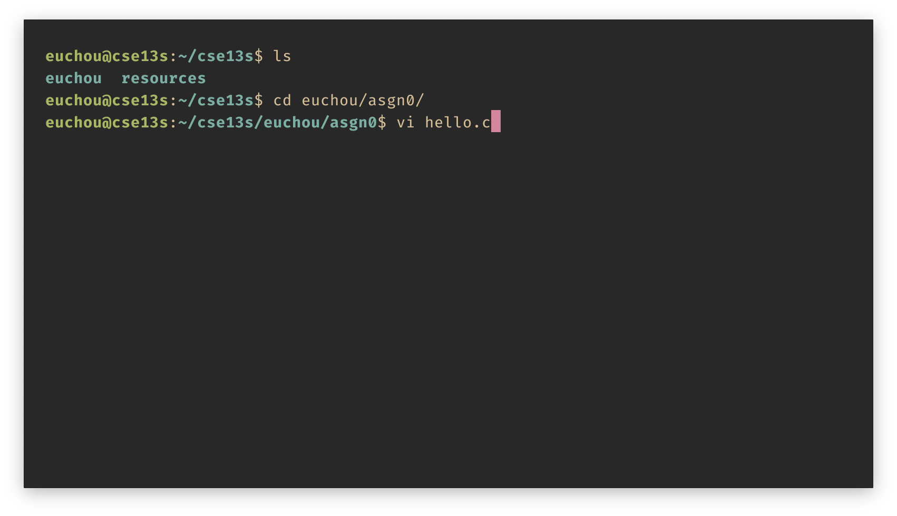
Start Work
List the files in the current directory
Enter the asgn0 directory
Create/edit hello.c

Slide 39
Vi/Vim
The pursuit of knowledge is never-ending. The day you stop seeking knowledge is the day you stop growing.
—Brandon Travis Ciaccio
Vi is the standard text editor found on Unix systems.
Vim is an acronym for “Vi IMproved” and is considered a clone of the Vi editor.
Most UNIX systems simply alias “vi” to “vim” so using either one is fine.
Functionally, Vim is almost a proper superset of Vi, thus everything in Vi as also available in Vim.
In general, use Vim when possible as includes built-in support for numerous programming languages and has been ported to a much wider range of OS’s than Vi.
Vim uses two different modes for text editing:
Normal mode (also called command mode)
Insert mode
We will only cover the basics of Vi/Vim to get you started.
If you wish to learn all the nuances of Vi/Vim, you will have to do so yourself.

Slide 40
Basic Vim Cheat sheet
H – move to top of screen
M – move to middle of screen
L – move to bottom of screen.
w – jump forwards to start of word
e – jump forwards to end of word
b – jump backwards to start of word
% – move to matching character (used for braces)
^ – jump to first non-blank character in line
gg – go to first line of document
G – go to last line of document
:wq – save and quit
r – replace a single character
cc – change (replace) entire line
C – change to end of the line
ciw – change in word
u – undo
CTRL+r – redo
. – repeat last command
yy – yank (copy) line into buffer
Y – yank to end of the line
p – paste from buffer
o – open new line below current line

Slide 41
Editors live in your fingers…
The commands are not obvious.
This is not unique to Vim, it is also true for emacs.
It requires practice!
It is a kind of muscle memory, like playing the guitar.
No one thinks “I need to type i now to insert”

Slide 42
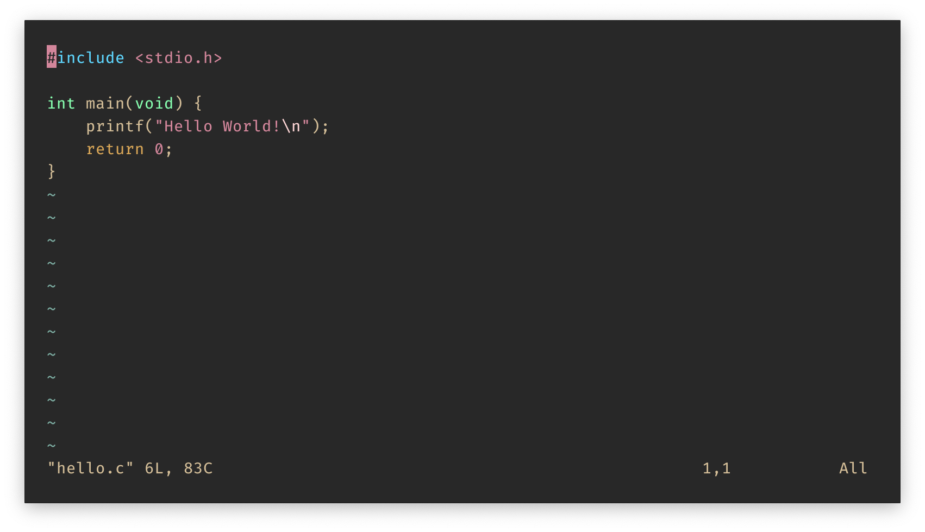
vi hello.c

Slide 43
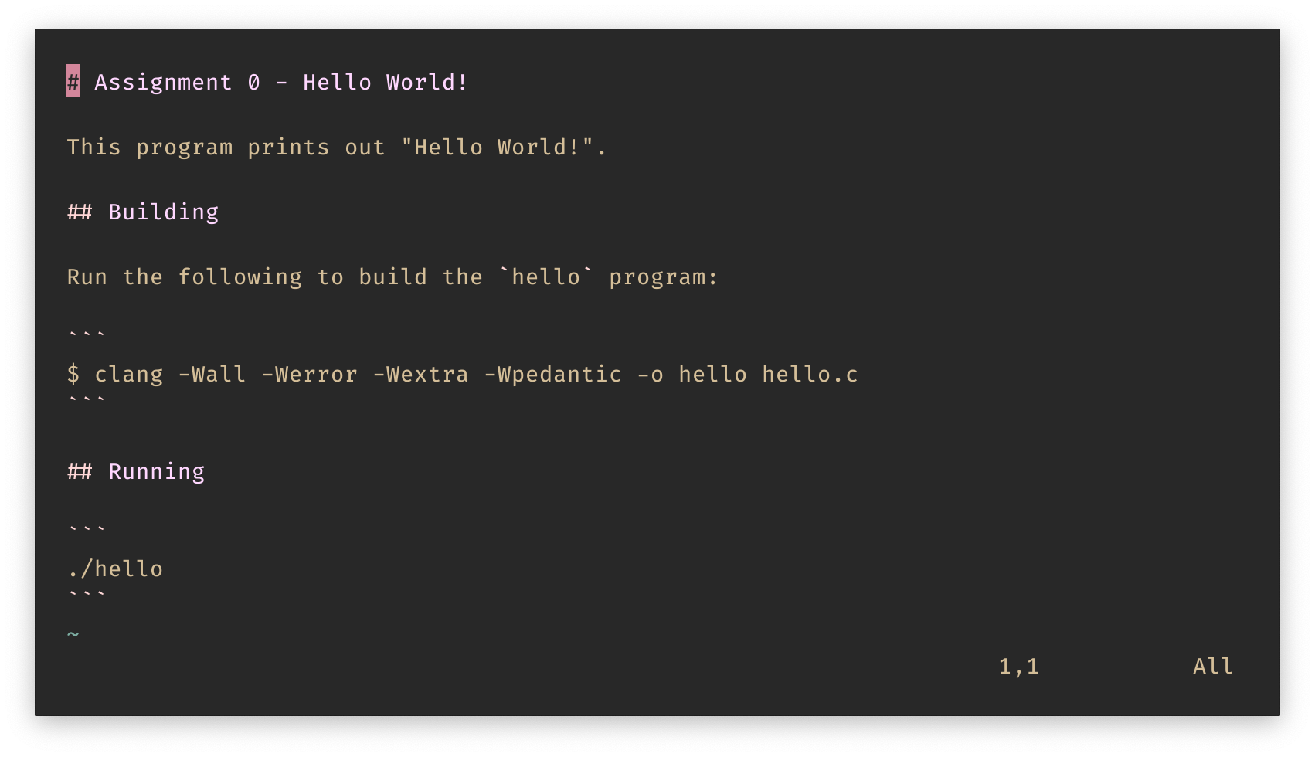
vi README.md
Oh no! A typo!

Slide 44
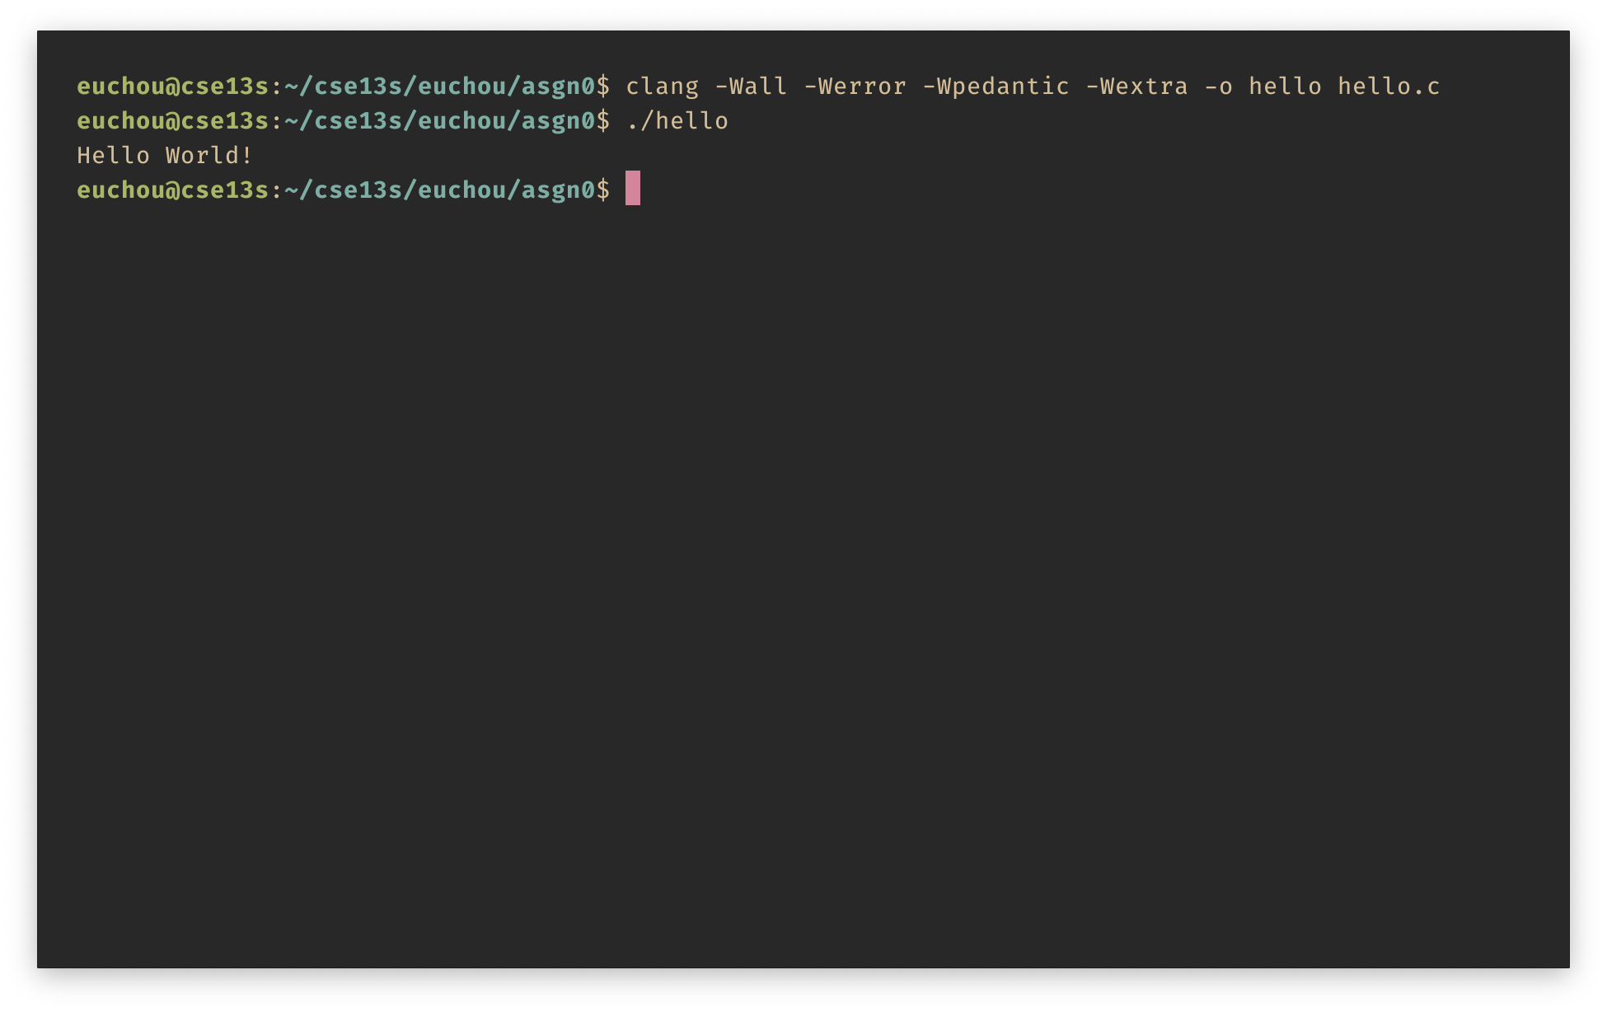
Does it work?

Slide 45
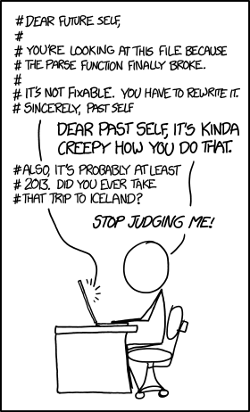
README.md
Describes:
What your program does,
How to build it,
How to run it, and
Any issues that it has.
Must be in Markdown format.

Slide 46
Documentation
The problem with the Internet is that it gives you everything – reliable material and crazy material. So, the problem becomes, how do you discriminate?
—Umberto Eco
There are two more required files:
DESIGN.pdf
WRITEUP.pdf
In this case they will both be very short, but in the future, they will be more detailed.
DESIGN.pdf
This document describes the design of your program and answers to any pre-lab questions.
It describes the algorithms and design decisions you have made.
It describes the problem that you are solving, inputs, and expected outputs.
WRITEUP.pdf
This document contains your analysis of running your program.
For example, if your assignment was to compare sorting algorithms this file would contain the results of that comparison.

Slide 47
DESIGN.pdf
It should be at a level that a programmer of your level could write the program.
It should not include C code —
This is design, not programming.
Pictures, diagrams, pseudocode are what we want.
It must be a PDF.
The first version must be pushed by Thursday.
This is not final but must show substantial effort.
This counts for 50%.
The final version must be pushed by Sunday.
This counts for 50%.
If you do not push on Friday, you get zero.

Slide 48
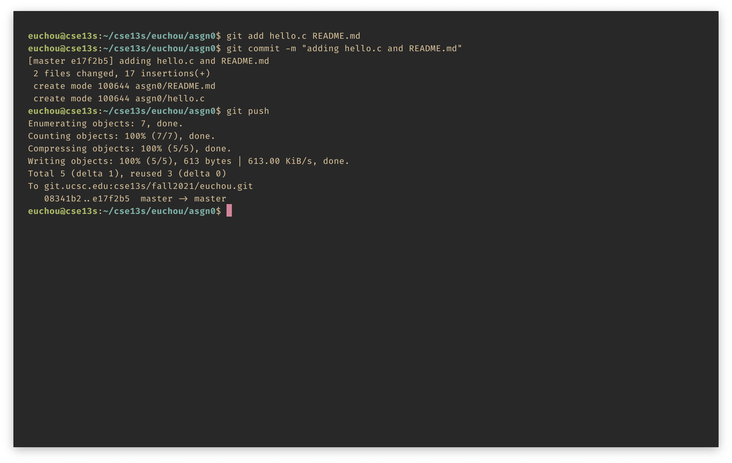
Submit using git
Add the files
Commit your changes
Push to the server

Slide 49
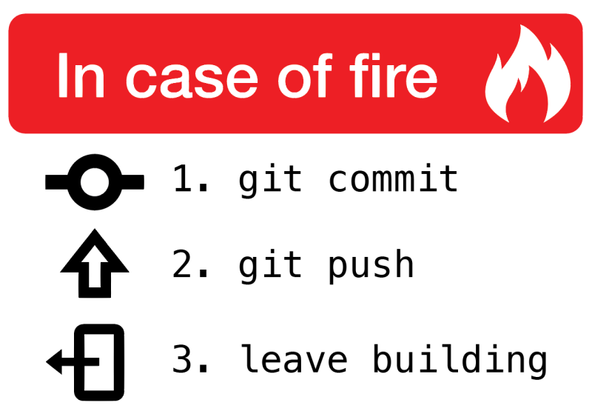

Slide 50
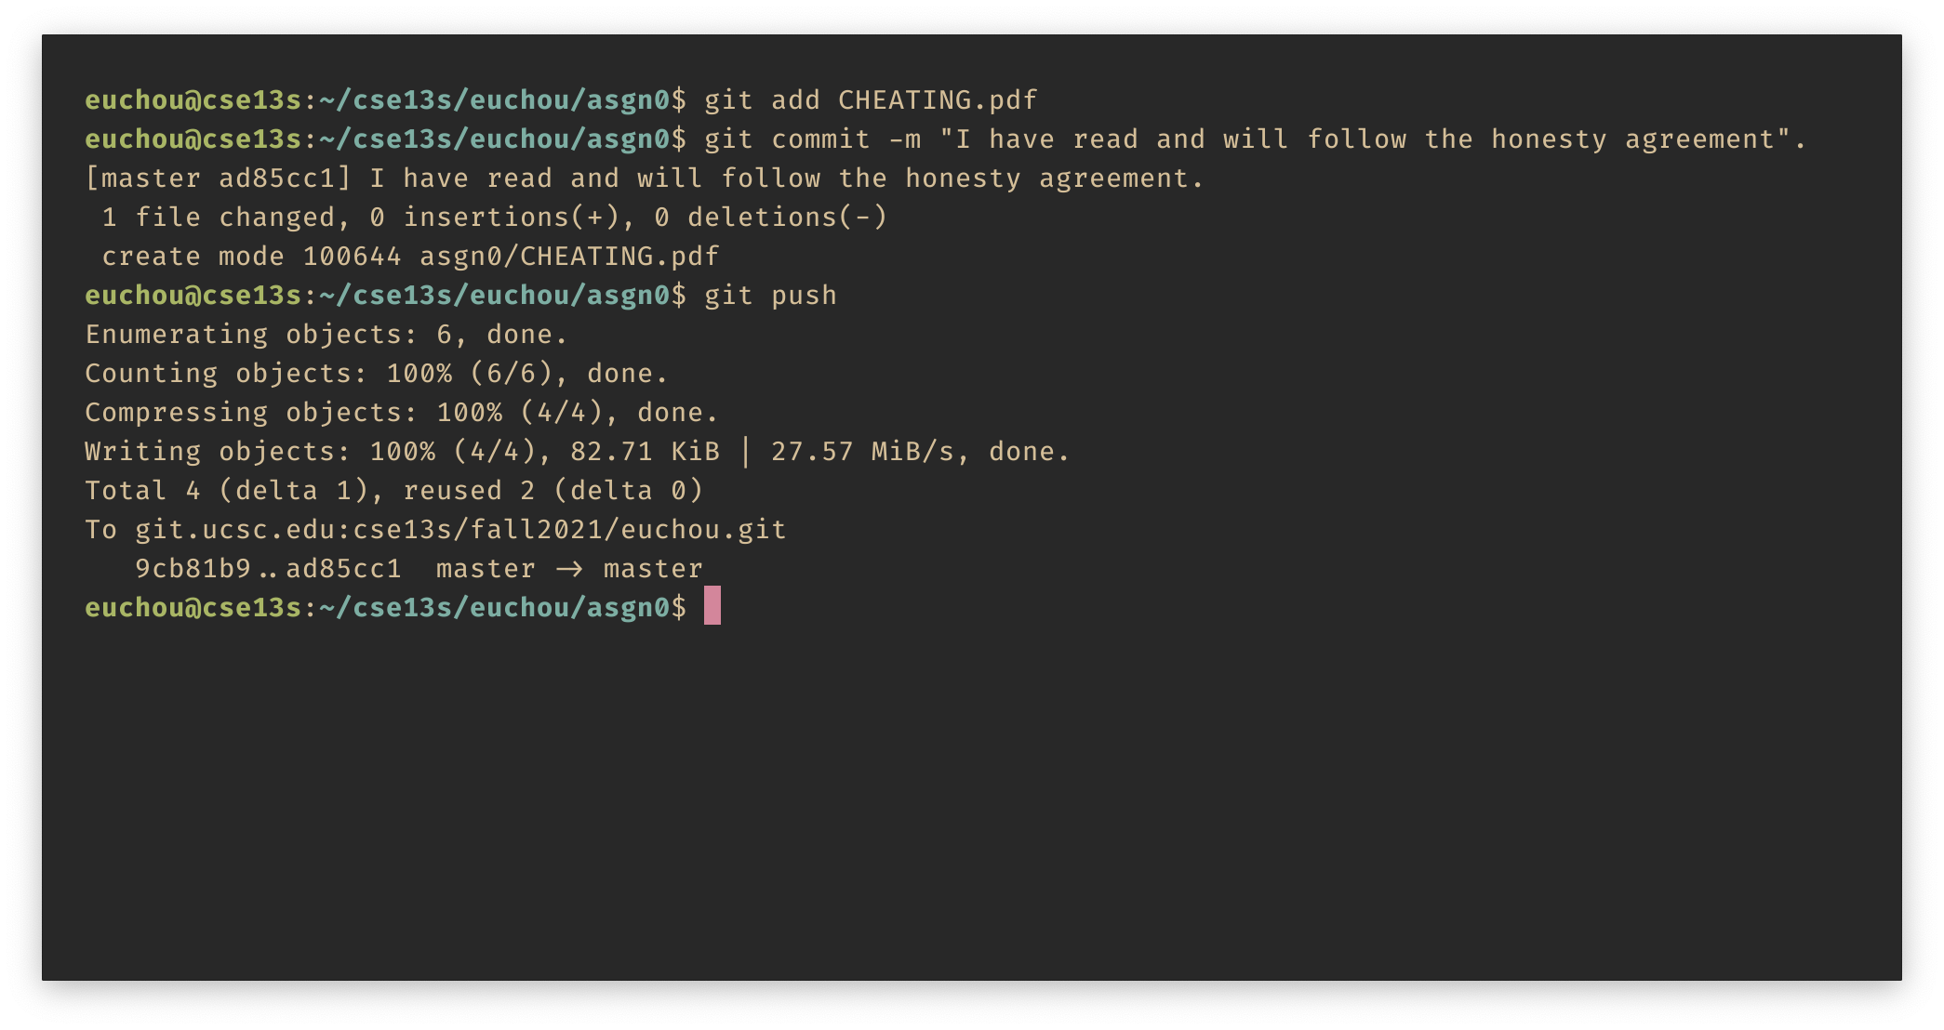
One more thing…
You must read the cheating policy.
You acknowledge having done so by submitting a PDF of the policy using git.
If you do not read and acknowledge the policy, then your assignments will not be graded.
Do this once for asgn0.

Slide 51
Lastly
Remember to always:
Add
Commit
Push
git is a powerful but complex tool.
If you use it correctly, it will save you from many unpleasant situations.
git tracks each commit, so you can always go back to a previous commit.
If you only use it to submit your work, then you are missing the point and lose all the benefits.

Slide 52
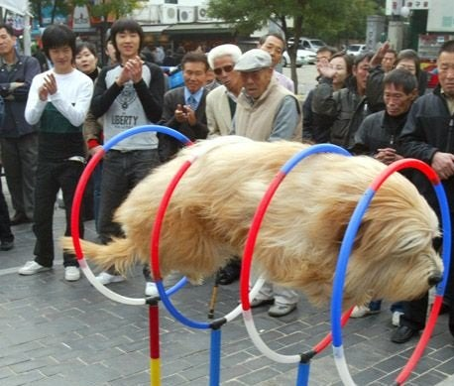
Summary
This class is not just another hoop for you to jump through:
You will use what you learn here from now on.
Take notes.
Ask questions.
Read the book.
Write the code.
Do not cheat:
It hurts you most of all.
Succeeding in this class will make subsequent classes much easier.
Your success is our goal!

